Slide 1
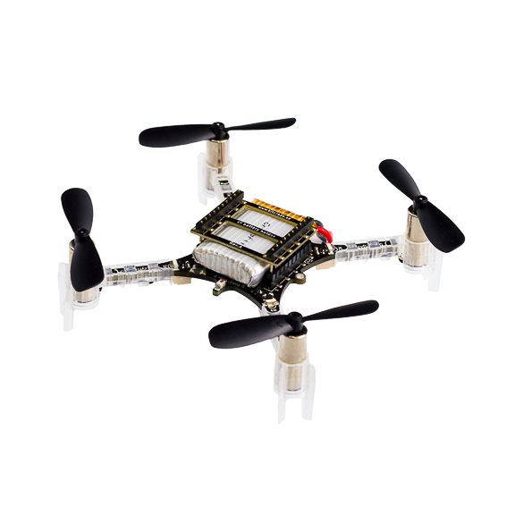
Planning and Control of a Quadrotor
EN530.678.S2021
Spring 2021
Jiahe Xu
Ray Zhang

Slide 2
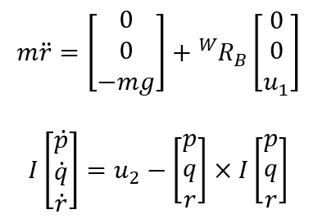
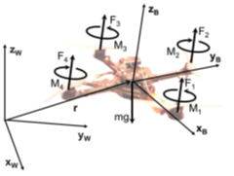


Quadrotor Model

Slide 3
Our method
read the map, build the environment with small cubes
find an initial path using shortest path algorithm
use CEM method finding a better path
apply minimum jerk polynomial method producing smooth trajectory

Slide 4
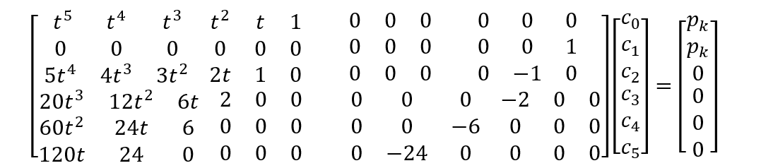
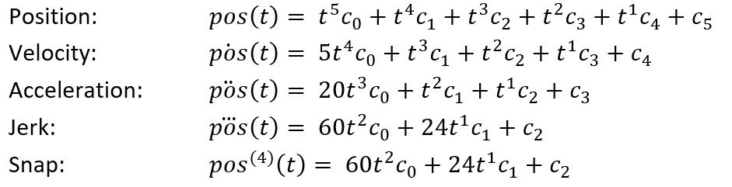
We used minimum jerk segments methods to generate the trajectory.
Segment k at pk
Segment k+1 at pk

Slide 5

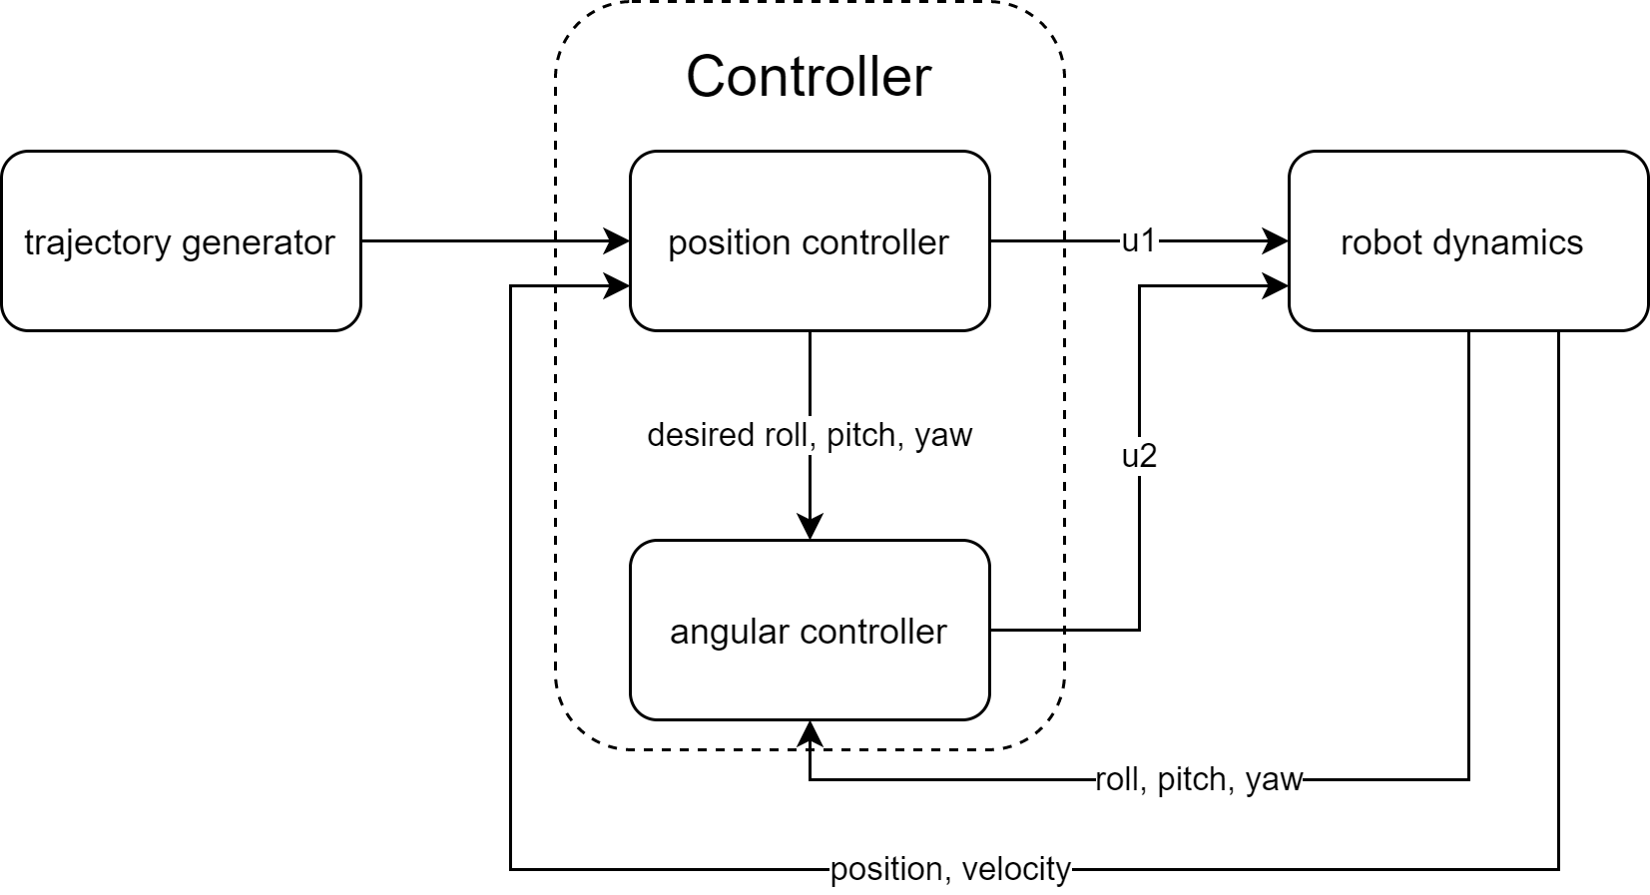
We used linear backstepping control to control the quadrotor to follow the trajectory.
total motor thrust
moment about the center

Slide 6
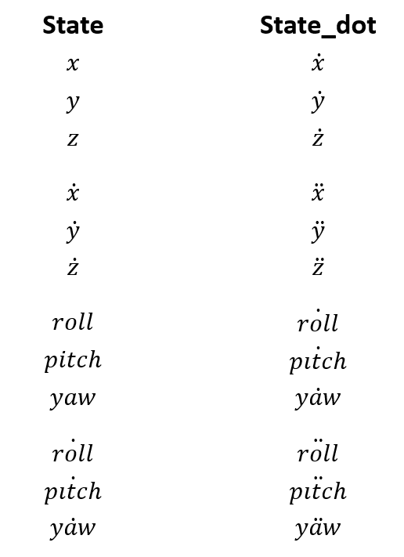
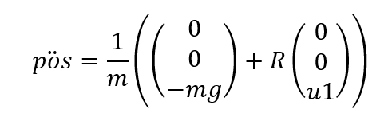
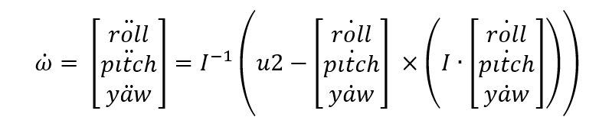
EOM takes U1 and U2 to evaluate State_dot.

Slide 7
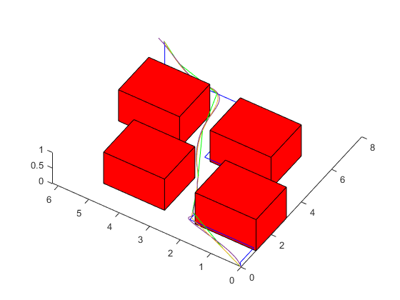
Results
theoretical shortest distance:11.05 our method: 11.64
Green: Shortest path
Yellow: Desired path
Purple: Actual path

Slide 8
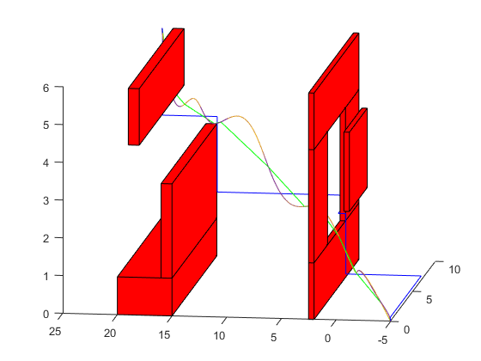
Results
theoretical shortest distance:27.59(directly from start point to goal) our method: 28.44
Green: Shortest path
Yellow: Desired path
Purple: Actual path

Slide 9
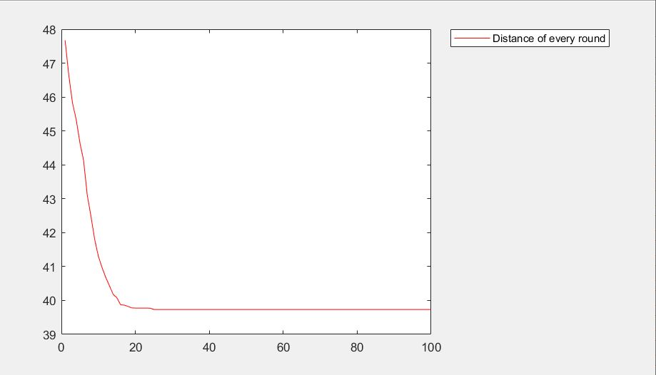
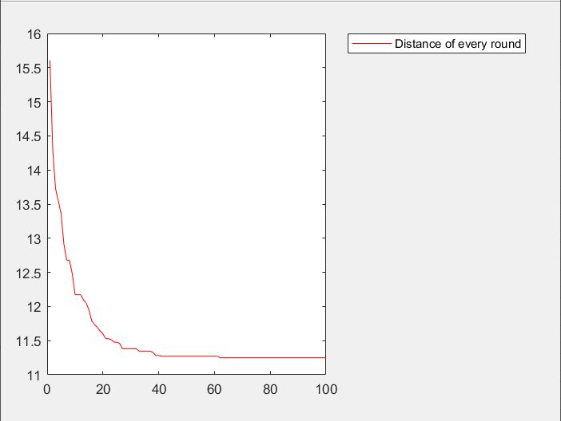
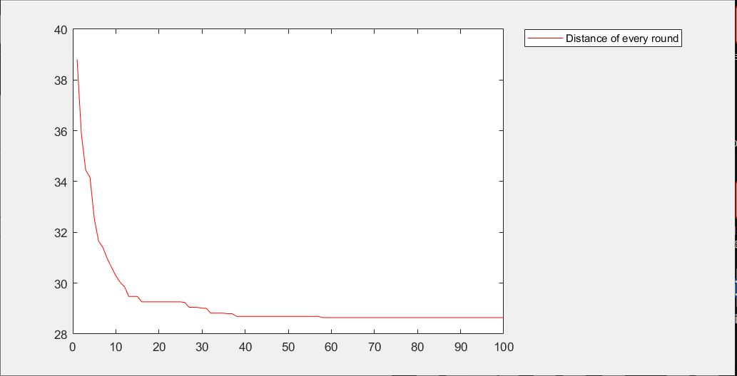
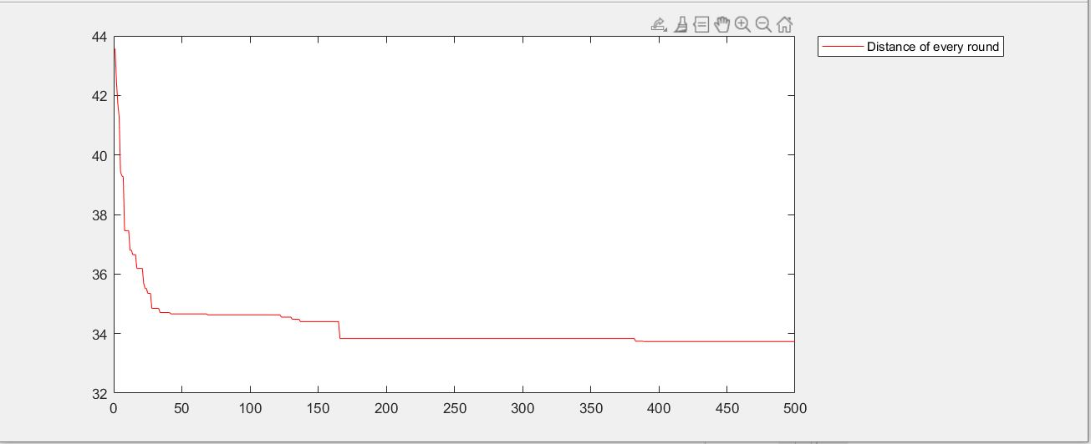
Results
Plots of Total Distance in each CEM iteration
map0
map1
map2
map3

Slide 10
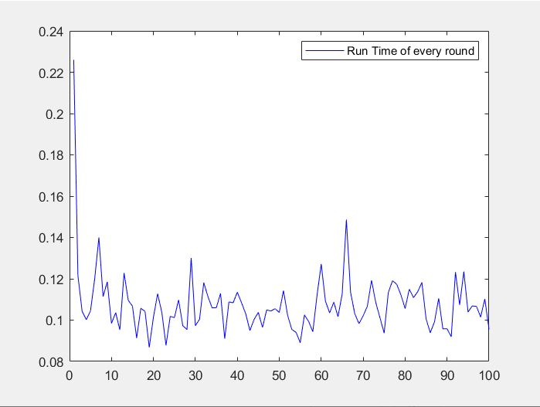
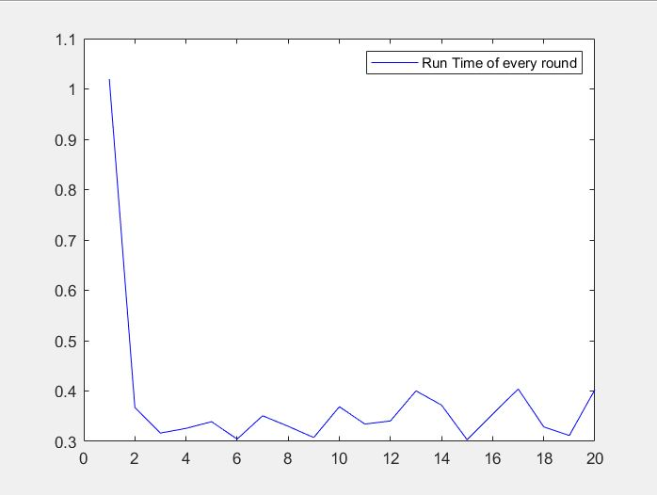
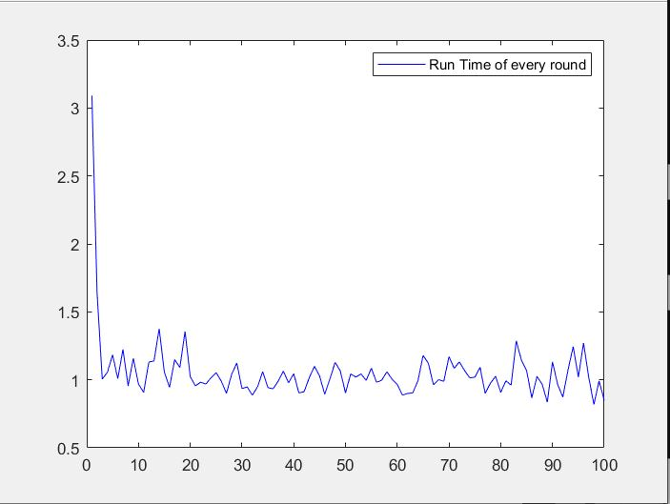
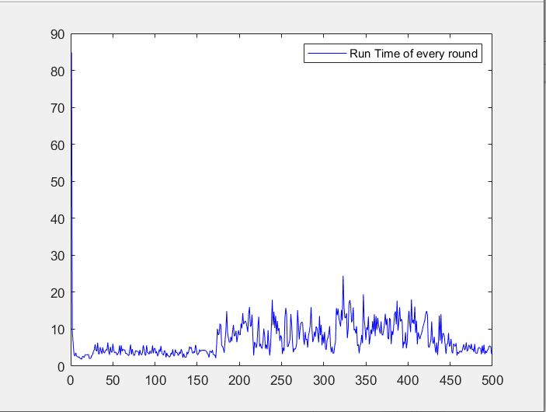
Results
Plots of Run Time in each CEM iteration
map0
map1
map2
map3

Slide 11
Questions?
Model
Trajectory generation
Controller
Equation of Motion
Results

Slide 12
Reference
https://alliance.seas.upenn.edu/~meam620/wiki/index.php?n=Main.Schedule

